Slide 1

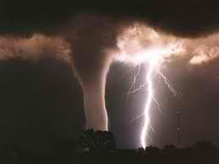
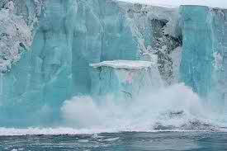
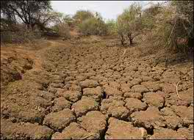
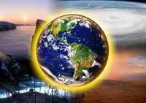
Climate Change

Slide 2
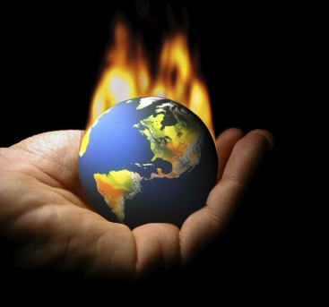
Report Outline
Introduction
Mechanism
Causes
Effects
Impacts
Mitigation
Conclusions and Recommendations

Slide 3
What is Climate Change?
- is any significant change in the measure of climate lasting for an extended period of time includes major changes in temperature, precipitation, or wind patterns, among other effects, that occur over several decades or longer.

Slide 4
Mechanism
of Climate Change
Radiative Forcing
Carbon Cycle
Greenhouse Gas Emission

Slide 5
Radiative Forcing
- a measure of the influence of a particular factor on the net change in Earth’s energy balance. A positive radiative forcing tends to warm the surface of the planet, while a negative forcing tends to cool the surface.

Slide 6
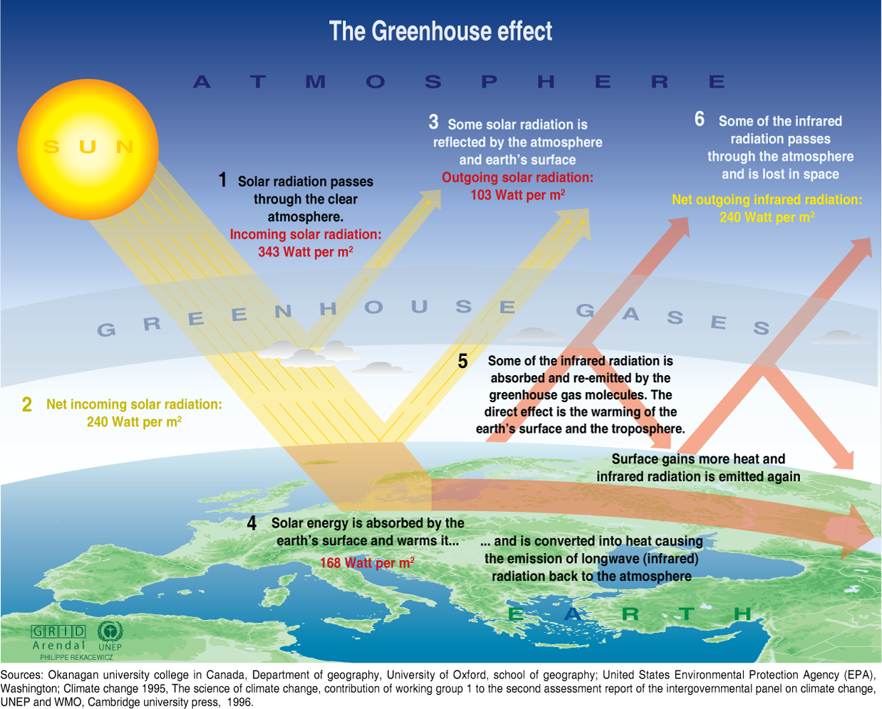

Slide 7
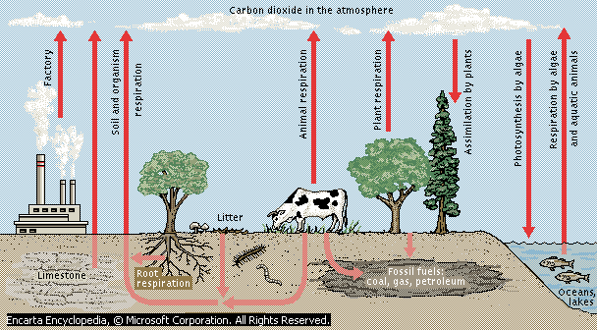

Slide 8
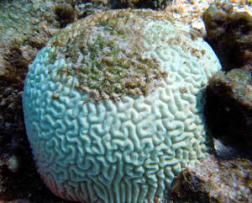
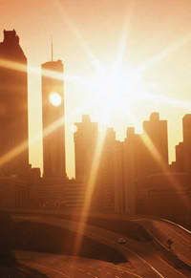
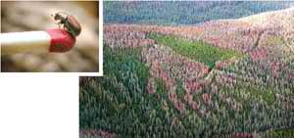

CAUSES
of Climate Change
Natural Causes of Climate Change
Human Causes of Climate Change

Slide 9
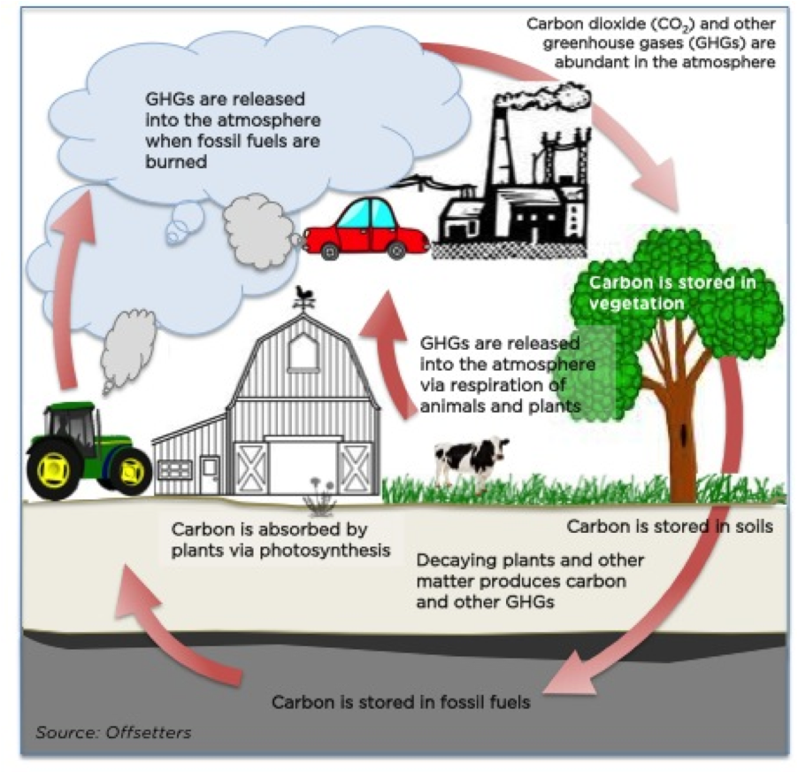

Slide 10
Natural Causes of Climate Change
Volcanic Eruptions
Ocean Current
The earth orbital changes
Solar variations
Global Warming

Slide 11
Human Causes of Climate Change
Fossil Fuels
Solid Waste
Leaking Coolants
Aerosols spray propellants
Sulfur Hexafluoride

Slide 13

EFFECTS
of Climate Change
Higher Temperatures
More Droughts

Slide 14

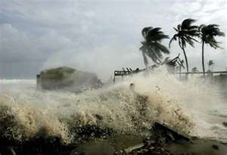

Wilder Weather
Changing Rain
and
Snow Patterns

Slide 15
Warmer Oceans
Less Snowpack
Melting Glaciers
Thawing Permafrost

Slide 16
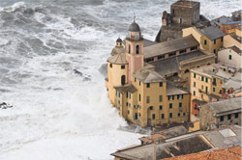
Increased Ocean
Acidity
Rising Sea Level

Slide 17
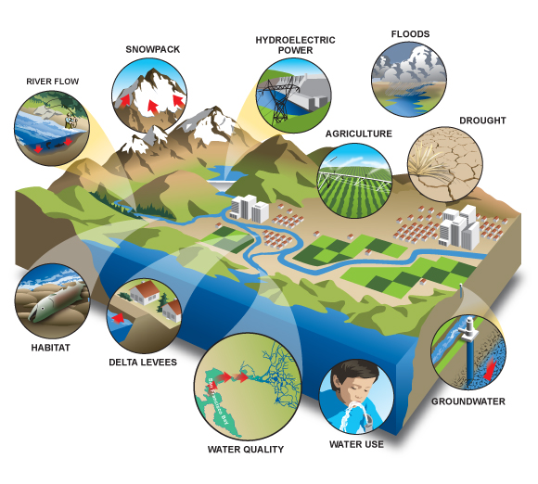
IMPACTS
of Climate Change
Agriculture and Food Supply
Coasts
Ecosystems

Slide 18
Energy
Forests
Health

Slide 19
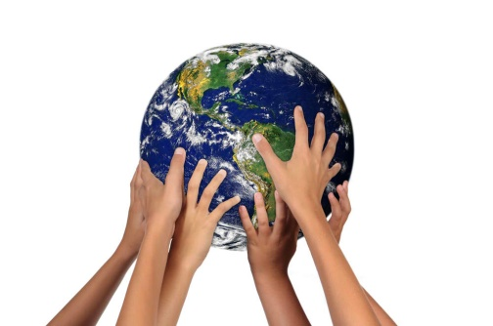
MITIGATION
greenhouse gas mitigation
carbon sequestration
Smoke Belching
Solar and Wind Power Energy
R.A 9003- Solid Waste Management
Solar power and Wind power
hydrogen fuel cells
Kyoto Protocol of 1997

Slide 20
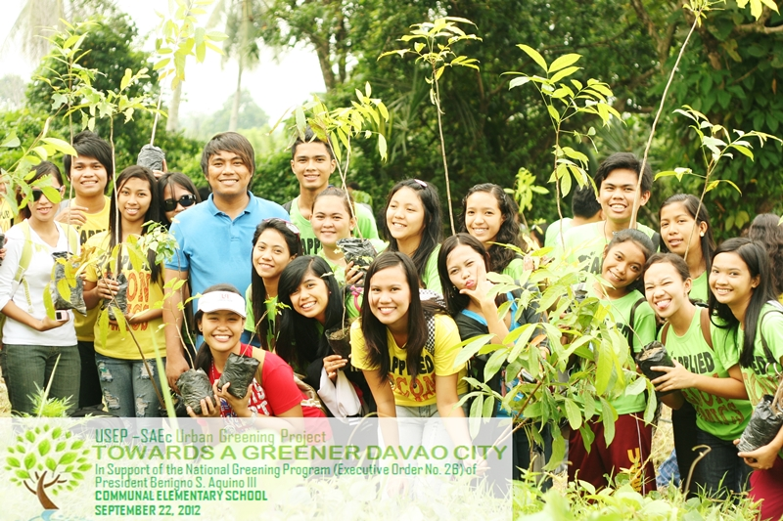
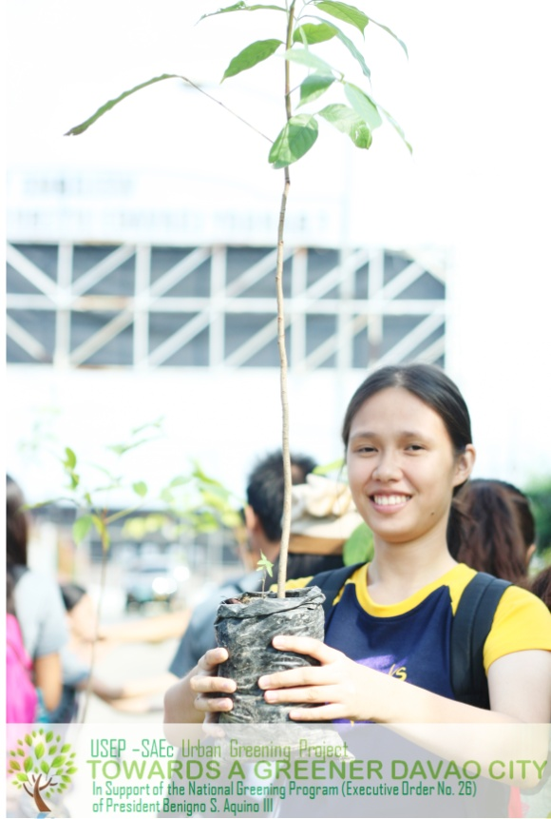
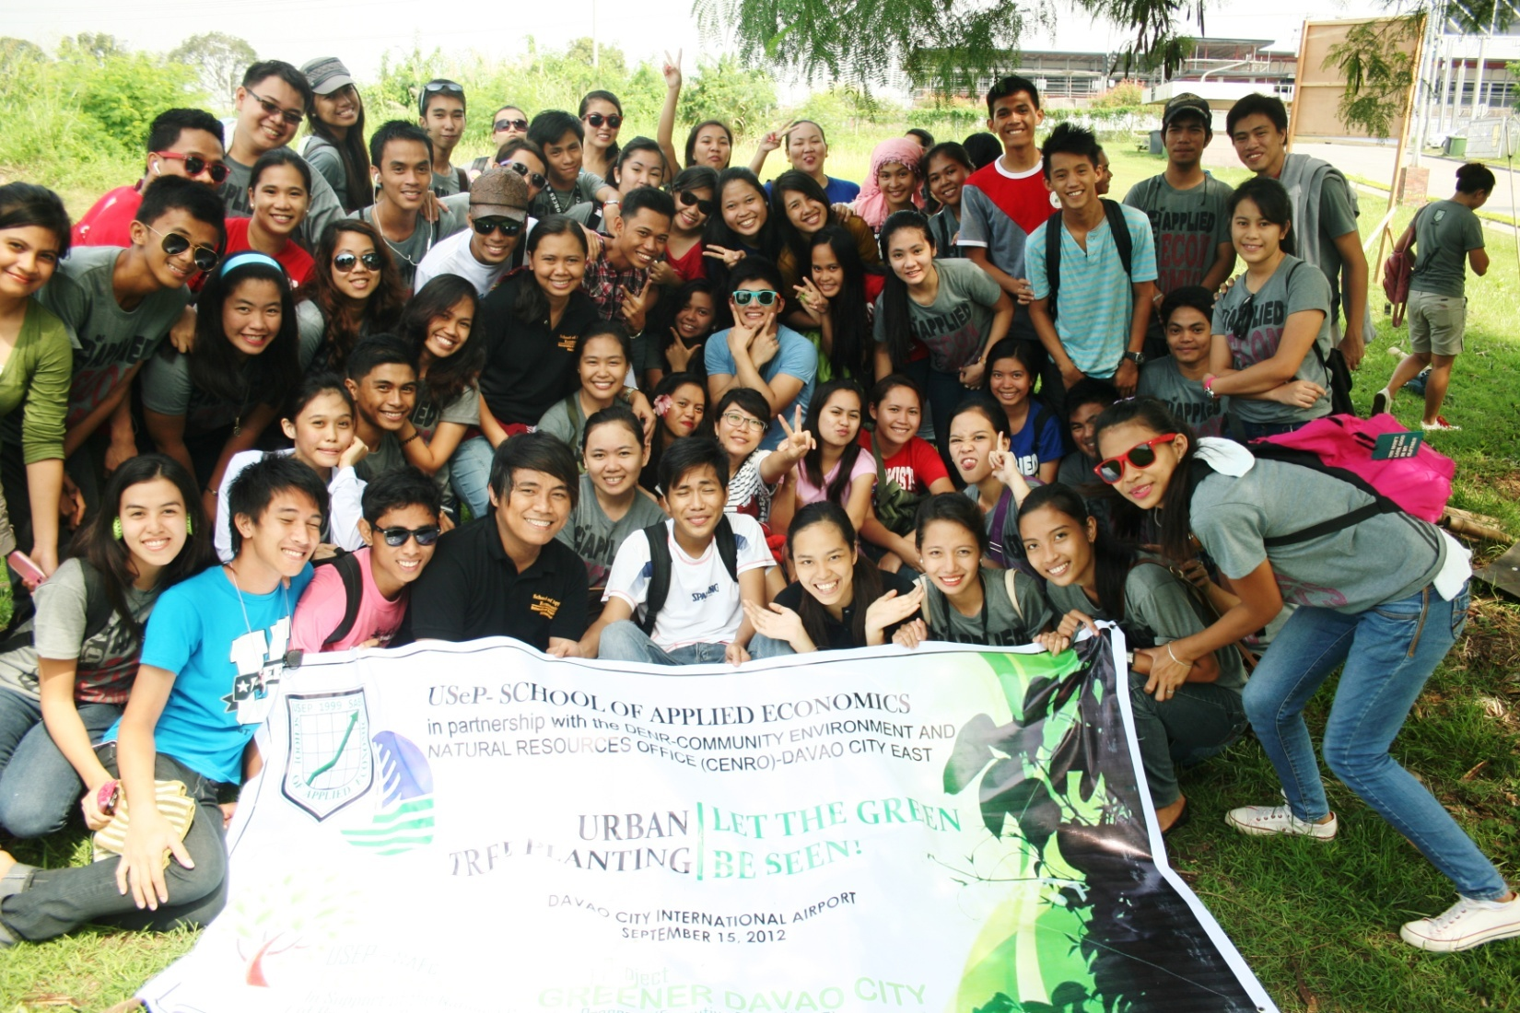
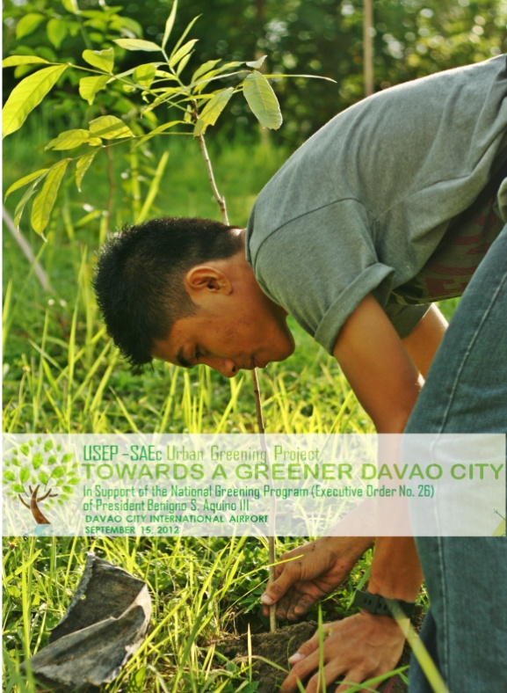

Slide 21

CONCLUSIONS and RECOMMENDATIONS
Climate change is not curable nor can slow down the effects of the manifestation to the society, economy, environment and the sustainability of the future planet. Climate Change has impacts to the global food supply because it can affect food prices at home. Food shortages abroad can pose humanitarian crises and national security concerns. The patterns of weather conditions will not anymore be predictable and ranges of impulsive weather conditions will be stronger and heavier.

Slide 22
Furthermore, there is a clear need to increase understanding of how ecosystem, social and economic systems human health and the built environment will be affected by climate change. Through taking steps like walking, jogging and using bicycles as substitute for the gas vehicles could reduce. These simple actions can lessen carbon footprints and to reduce the emissions of GHG. All we have to do is conserve water, electricity and taking actions before it’s too late.

Slide 23
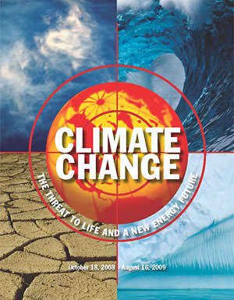
Let’s Save the Earth!
REUSE
REDUCE
Fight !
RECYCLE

Slide 24
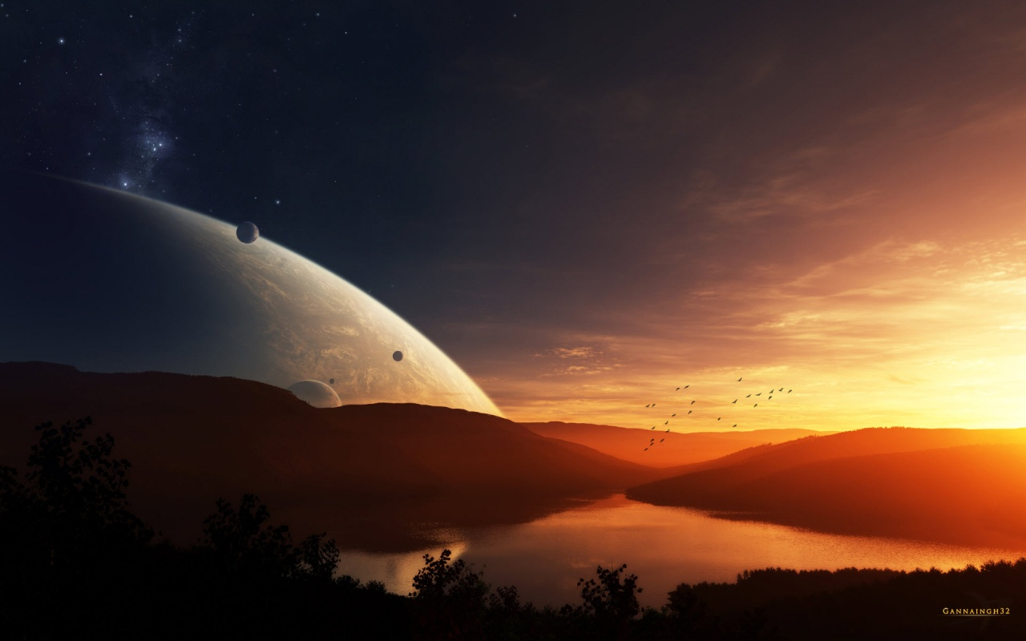

Thank You for
Listening !!!

